Slide 1
EL Dorado: CITY OF GOLD

Slide 2
YARADA: VUDA Layout

Slide 3
General Site Topography

Slide 4
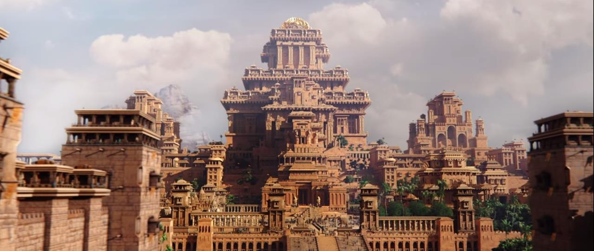
Architectural Theme: City of Gold

Slide 5
Roller Coasters
Bolliger & Mabillard - Medusa

Slide 6
Thrill Rides

Slide 7
Family Rides

Slide 8
Kids Rides

Slide 9
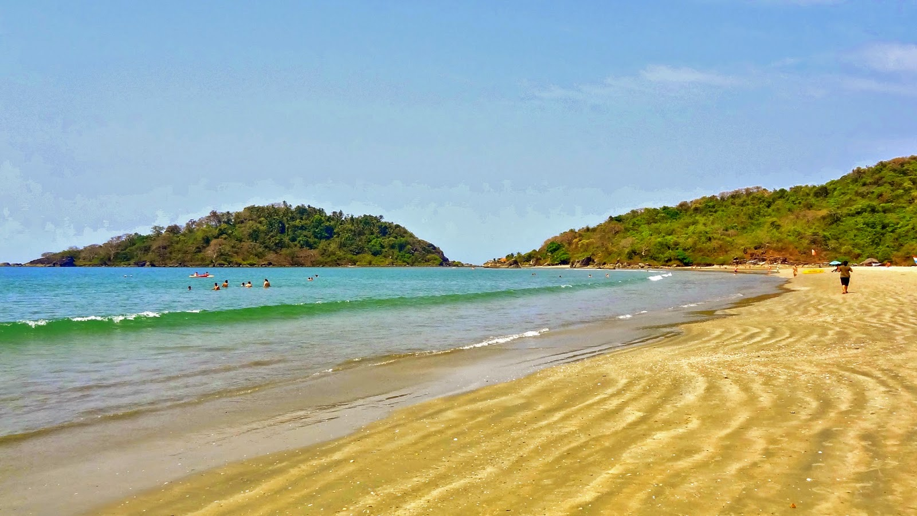
Views

Slide 10
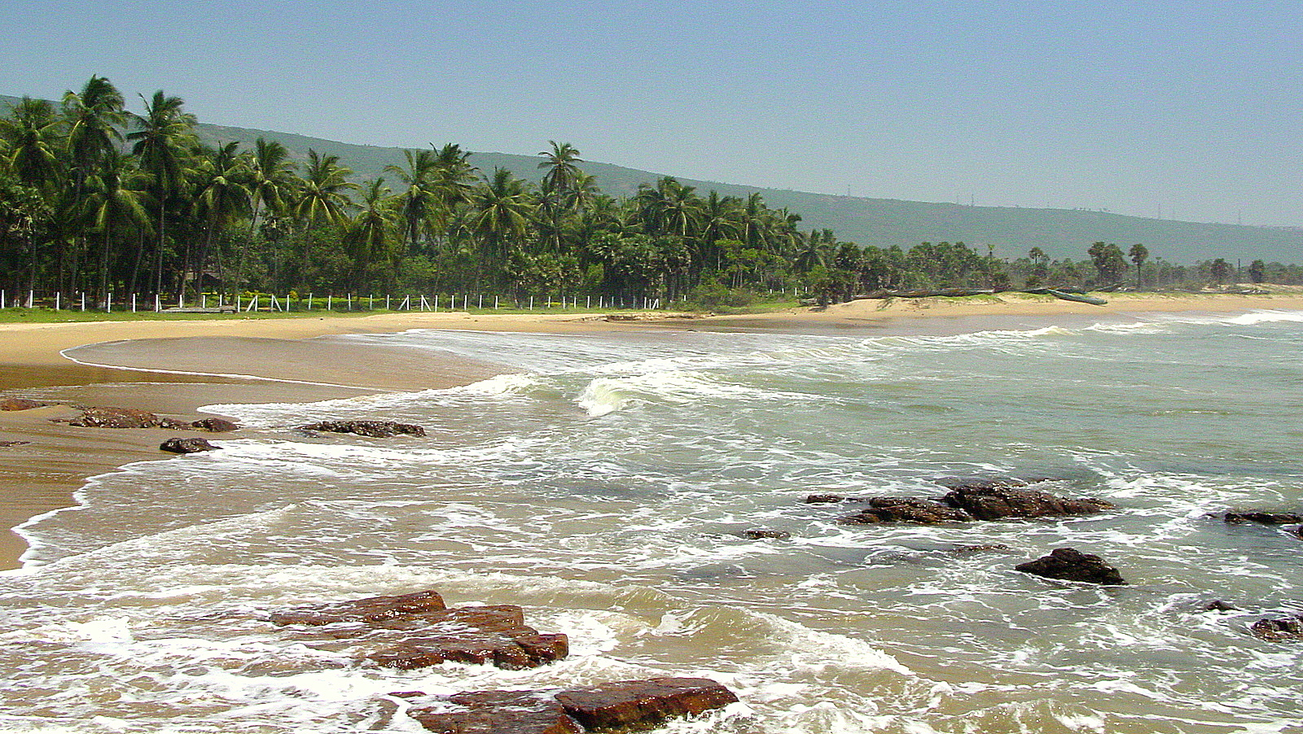

Slide 11
Golden Sunrise: Phase 1

